Slide 1


Protractor – Deep Dive
Prepared By: Shrish Tripathi

Slide 2
conf.ts

Slide 3
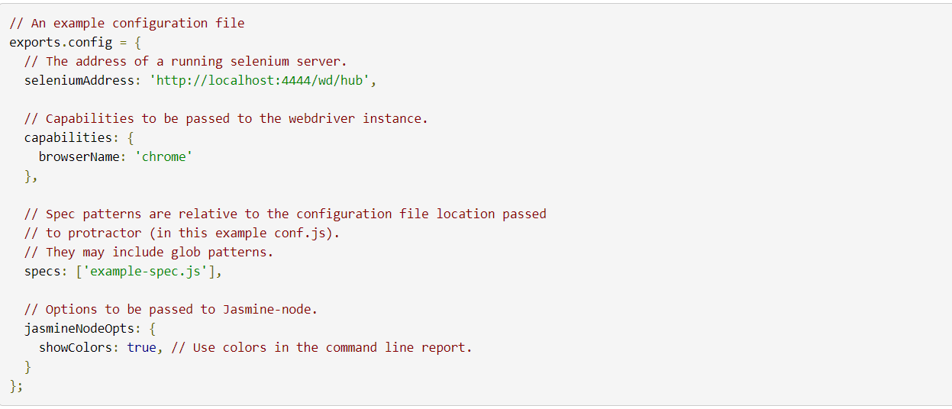

Slide 4
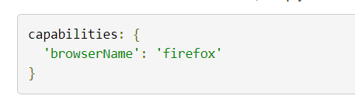
Setting Up the Browser
using Browsers Other Than Chrome

Slide 5
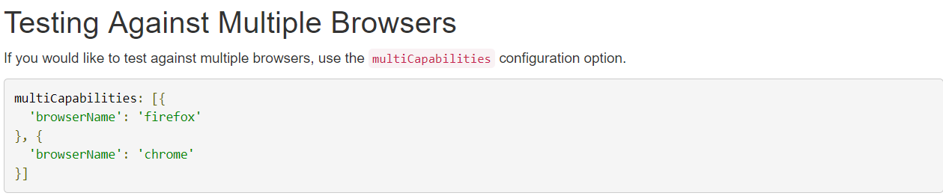
Multiple Browser

Slide 6
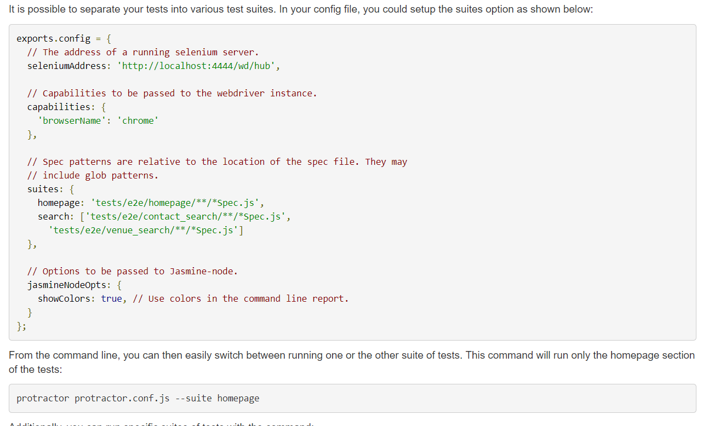
Multiple Test Suite- conf.ts

Slide 7
Design
Basic Approach vs Best practices

Slide 8
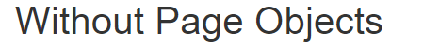
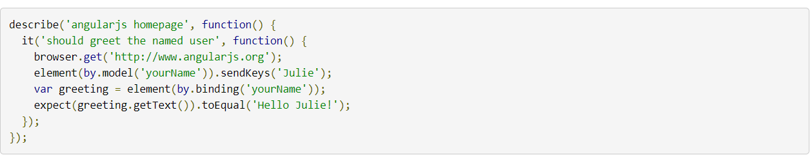
Basic Approach

Slide 9
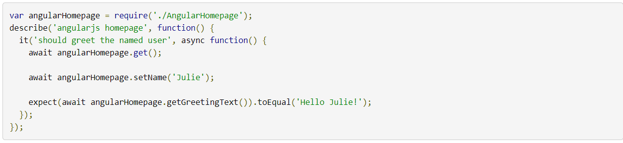
Best Practice (POM)

Slide 10
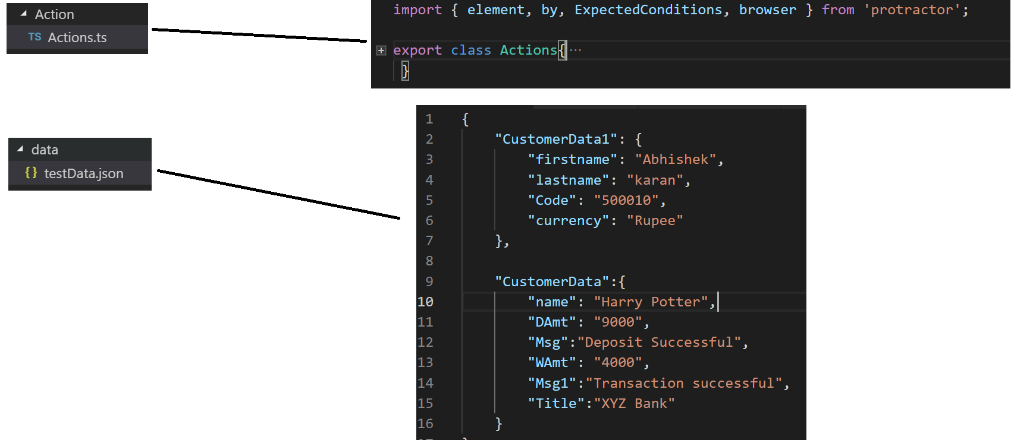
Action – Reusable Library

Slide 11
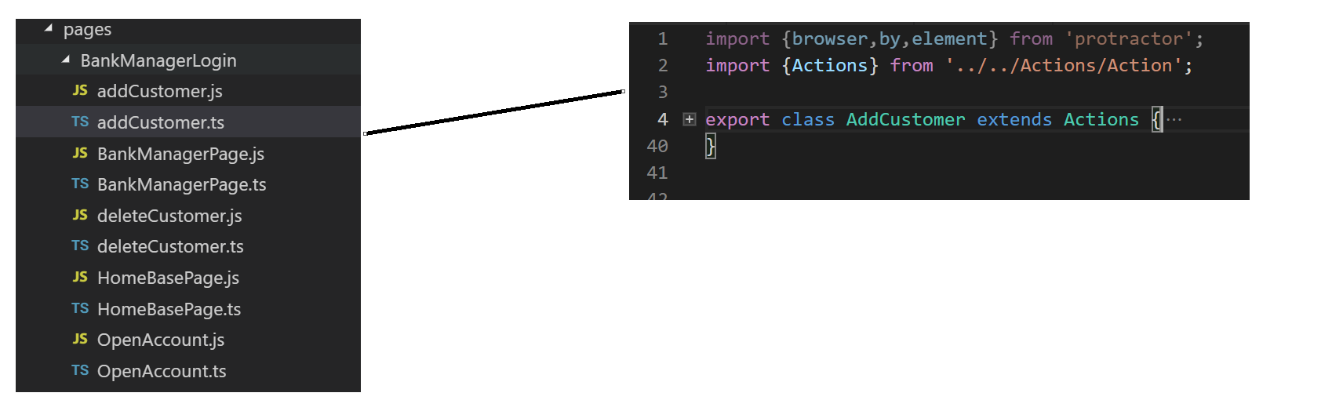
Pages – Locators based on Pages- Library

Slide 12
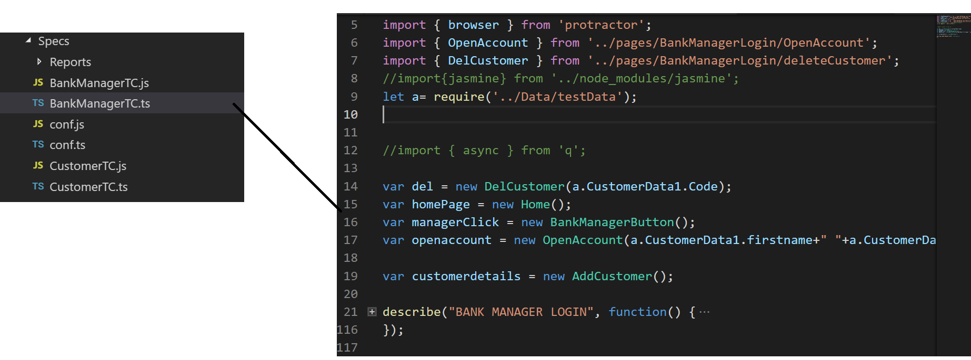
Spec – All test Cases

Slide 13
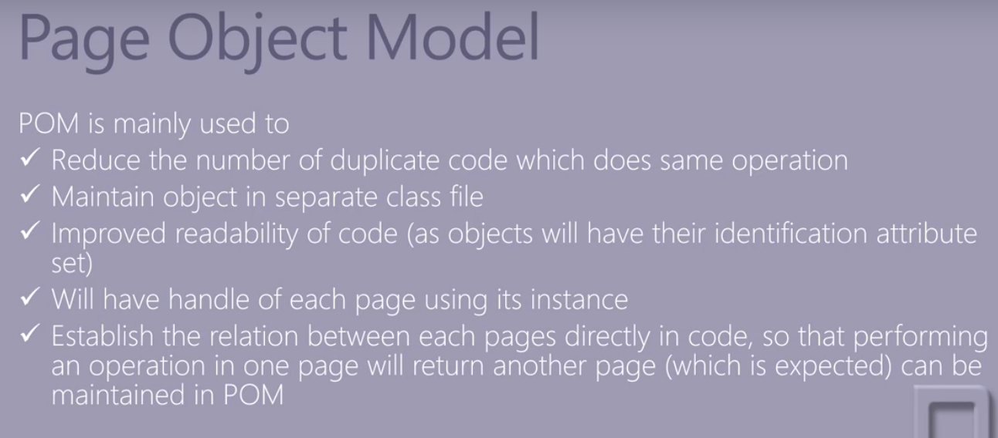

Slide 14
WbdriverJS Promise and async/wait

Slide 15
Promises in webdriverJS

Slide 16
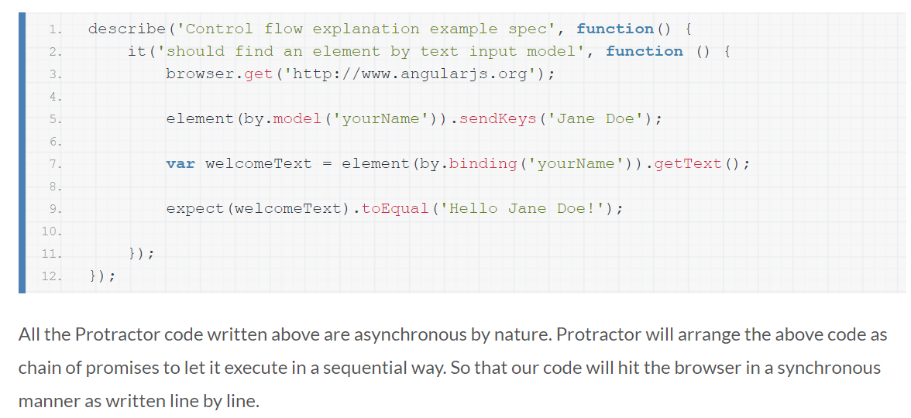
Let’s understand first… Control Flow!!

Slide 17
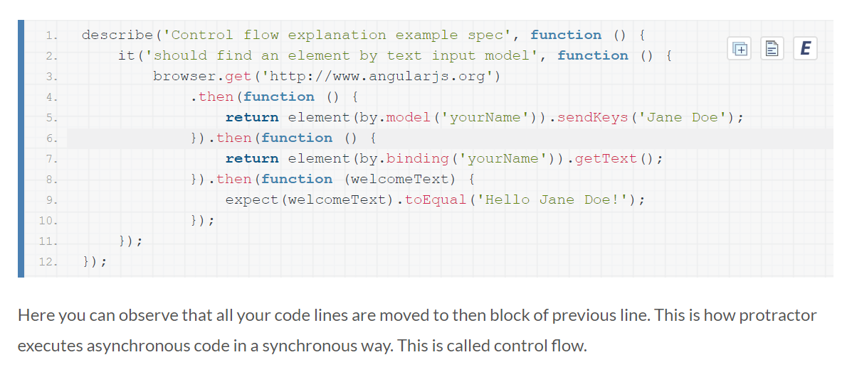
What Protractor doing internally…

Slide 18
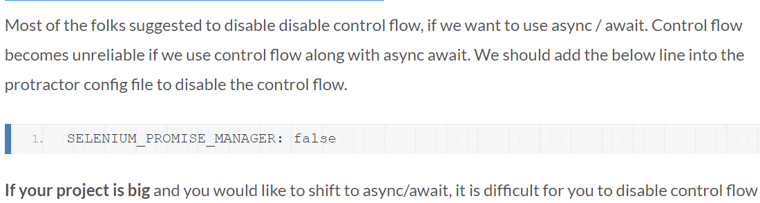
Moving to async/await

Slide 19
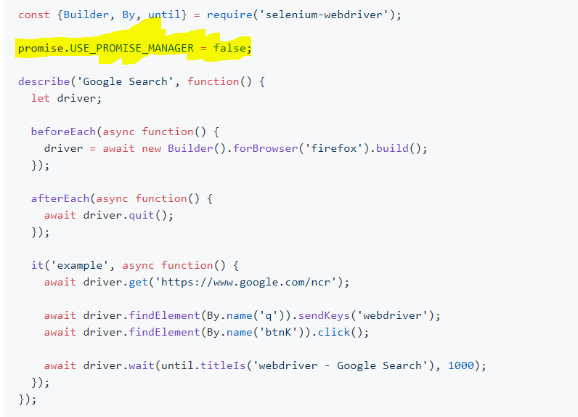

Slide 20
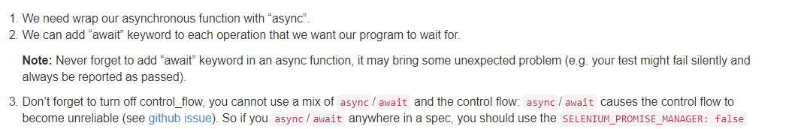

Slide 21
browser

Slide 22
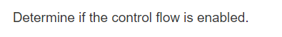
browser.controlFlowIsEnabled

Slide 23
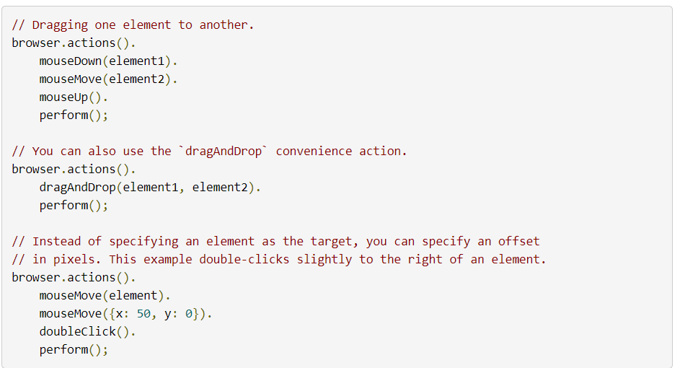
browser.action

Slide 24
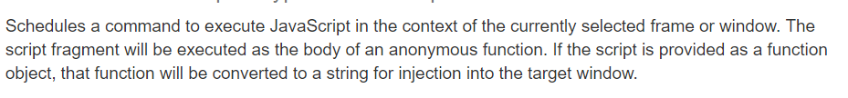
Browser.executeScript(argument, document) /webdriver.WebDriver.executeScript

Slide 25
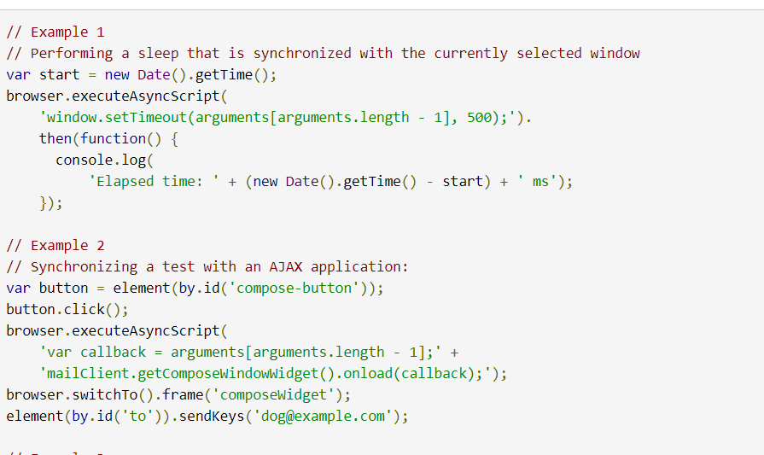
Browser. executeAsyncScript

Slide 26
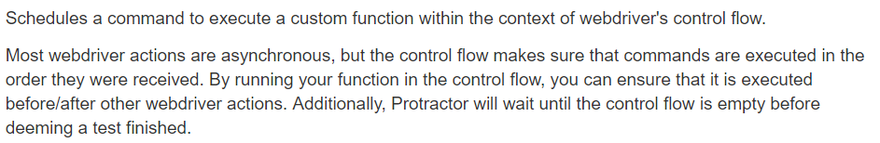
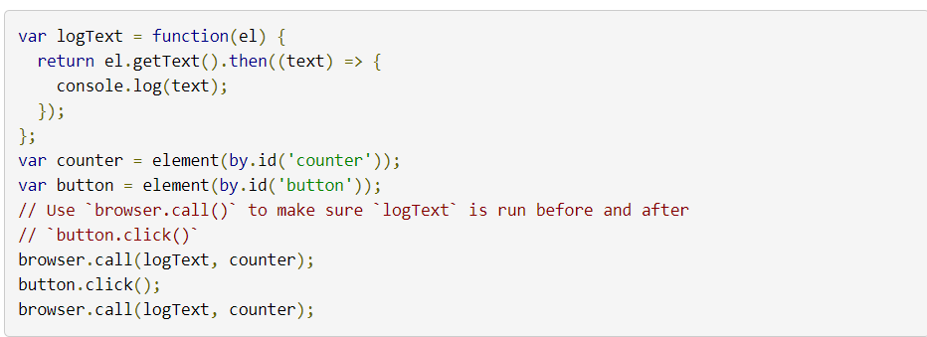
browser.call

Slide 27
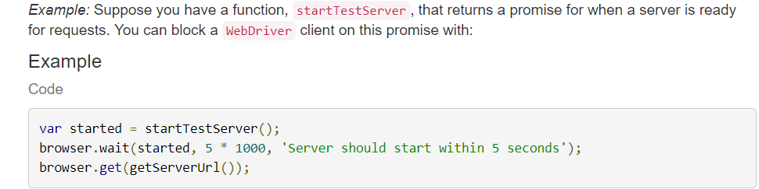
browser.wait

Slide 28
Browser.sleep
same like wait..

Slide 29
Browser.getPageSource

Slide 30
Browser.close

Slide 31
Browser.getCurrentUrl

Slide 32
browser.getTitle

Slide 33
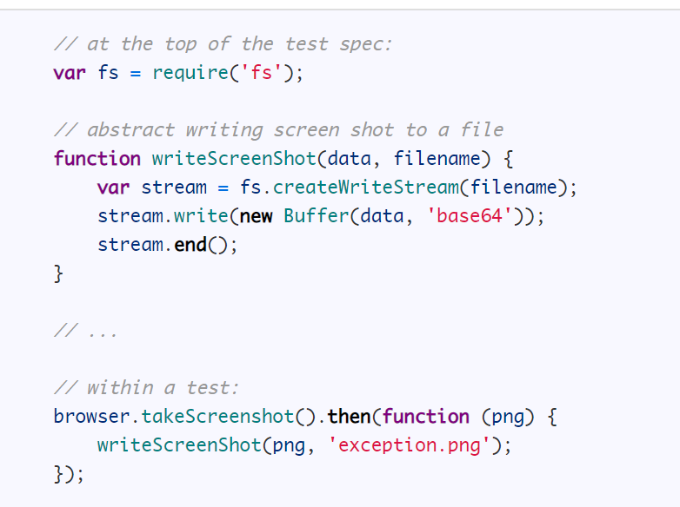
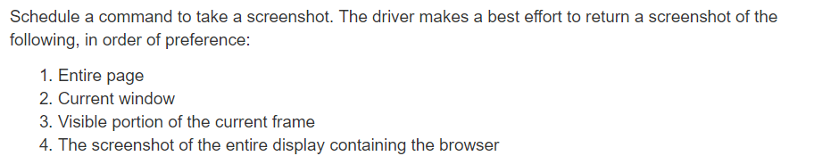
browser.takeScreenshot

Slide 34
browser.switchTo

Slide 35
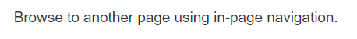
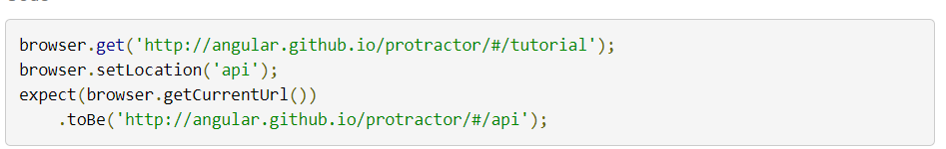
browser.setLocation

Slide 36
browser.refresh

Slide 37
browser.get

Slide 38

browser.isElementPresent

Slide 39
browser.findElements

Slide 40
browser.findElement

Slide 41
browser.waitForAngular

Slide 42
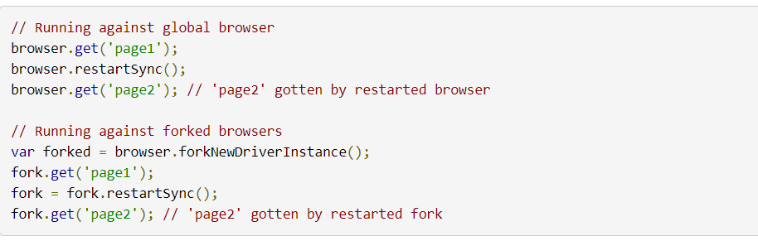
browser.restartSync

Slide 43
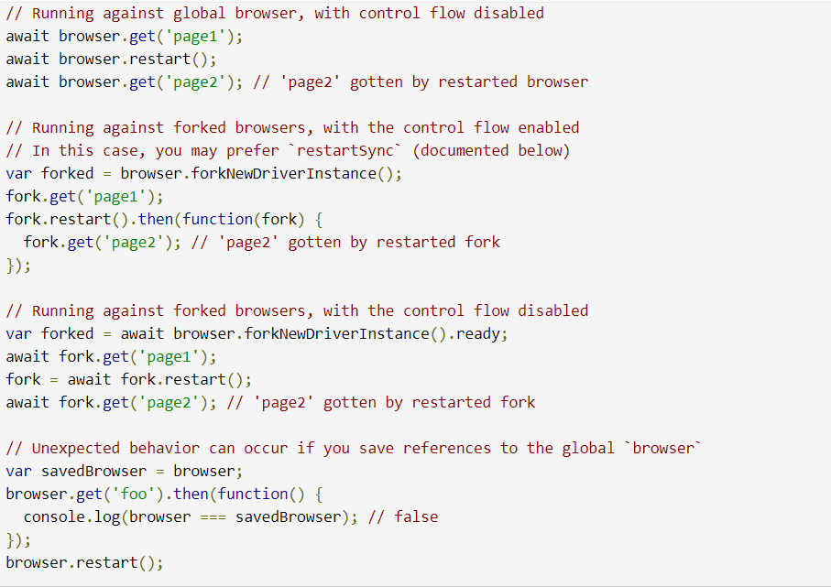
browser.restart

Slide 44
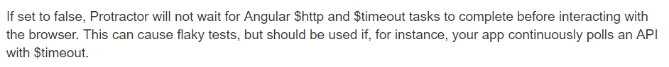
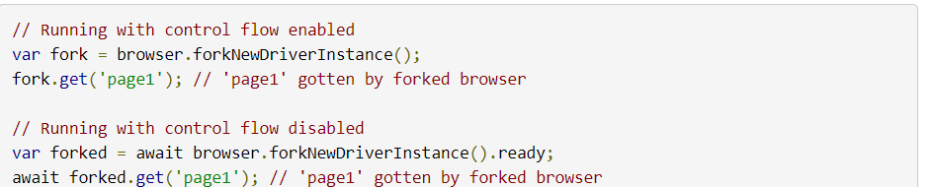
browser.waitForAngularEnabled

Slide 45
element(locator)

Slide 46
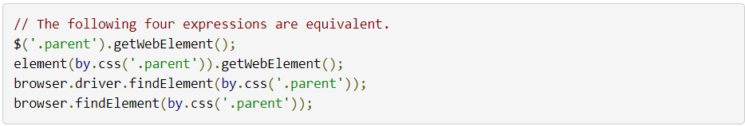
element(locator).getWebElement()

Slide 47
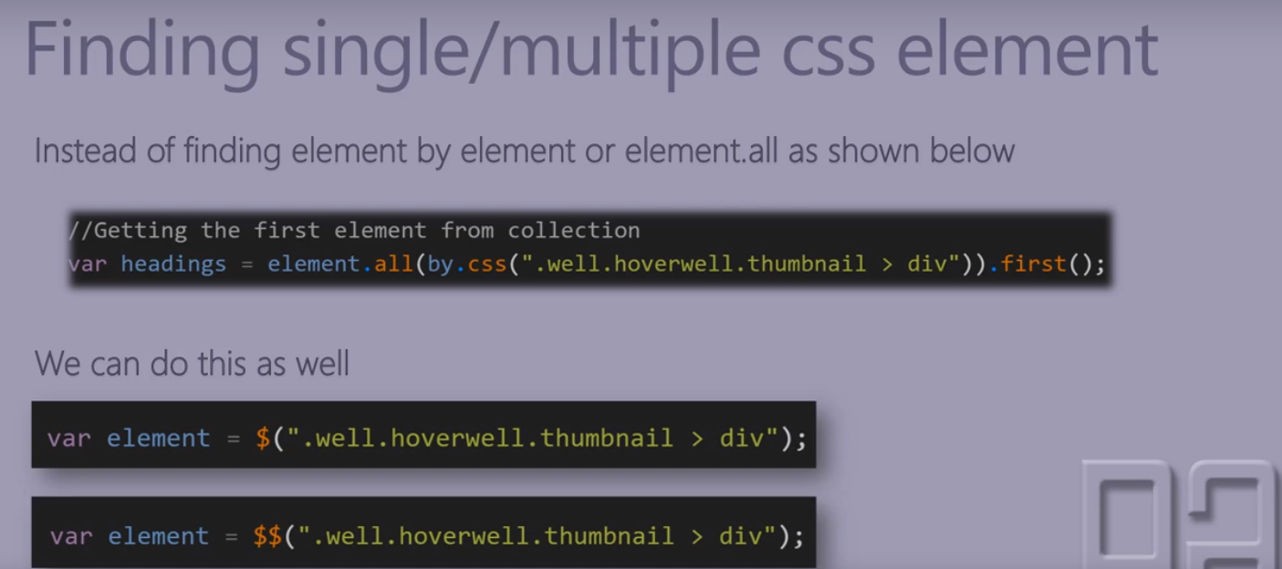
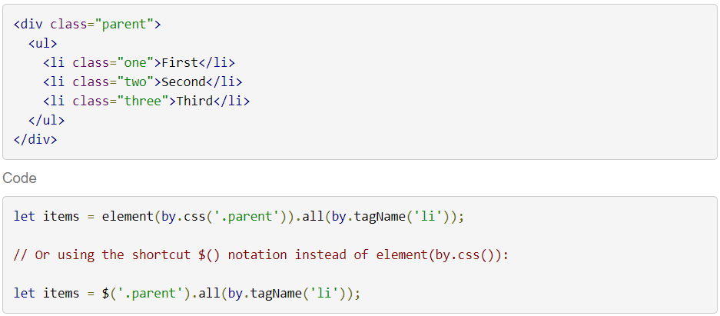
element(locator).all(locator)

Slide 48
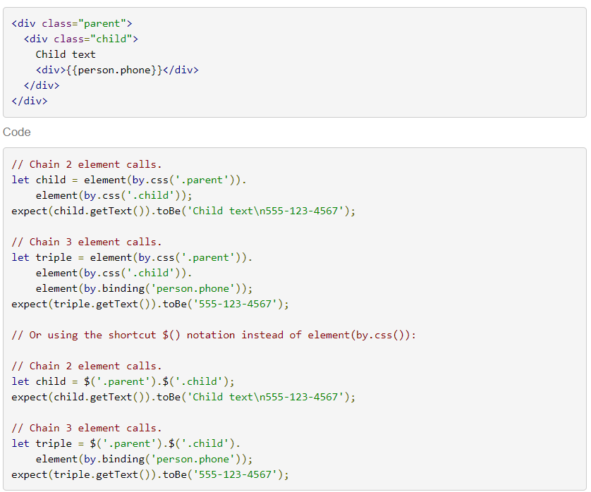
element(locator).element(locator)

Slide 49
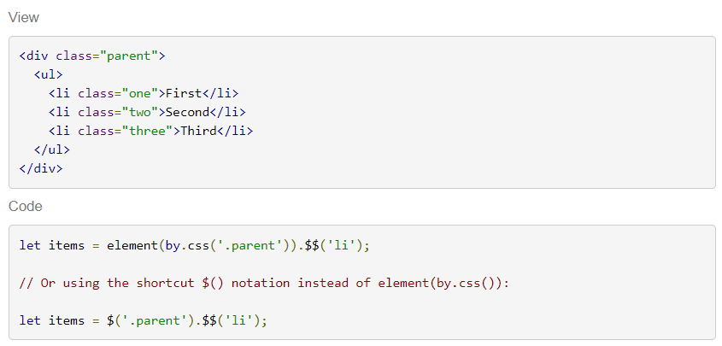
element(locator).all(selector)

Slide 50
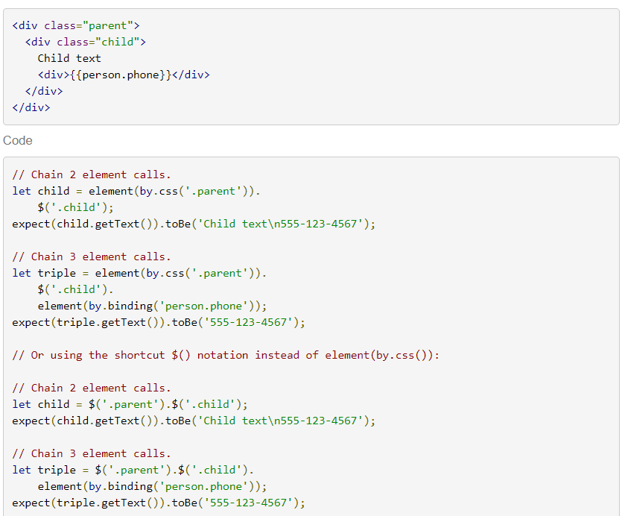
element(locator).$(selector)

Slide 51
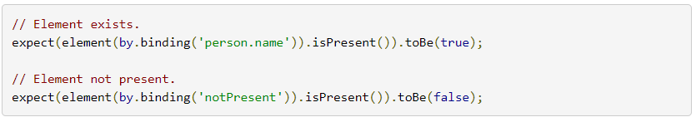
element(locator).isPresent

Slide 52
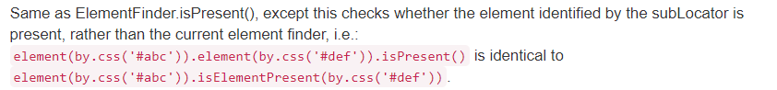
element(locator).isElementPresent

Slide 53
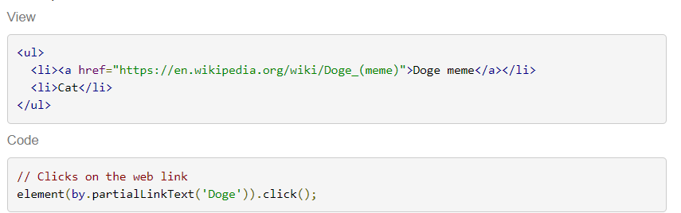
element.click

Slide 54
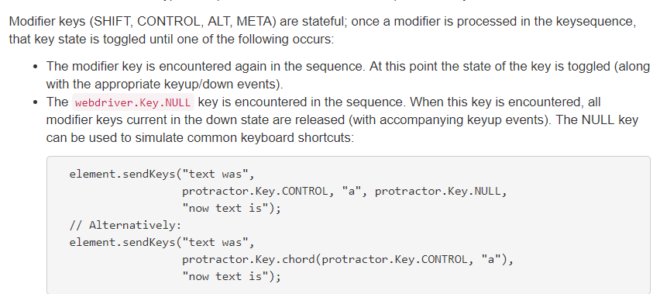
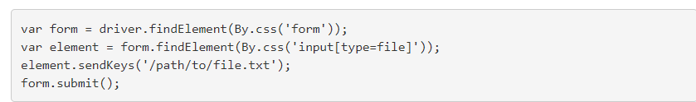
element.senkeys

Slide 55
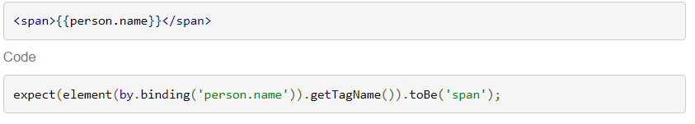
Element.getTagName

Slide 56
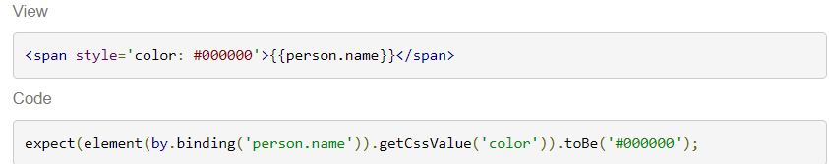
Element.getCssValue

Slide 57
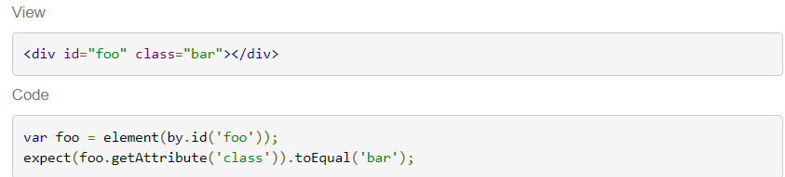
Element.getAttribute

Slide 58
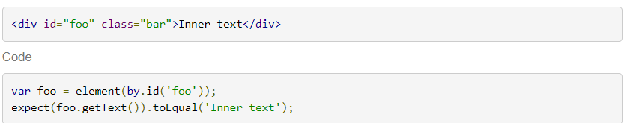
Element.getText

Slide 59
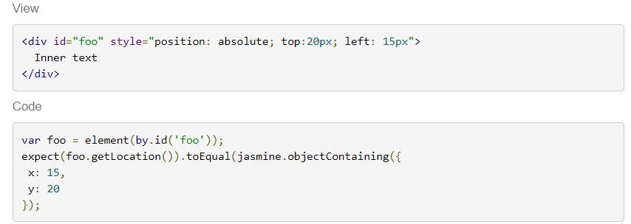
Element.getLocation

Slide 60
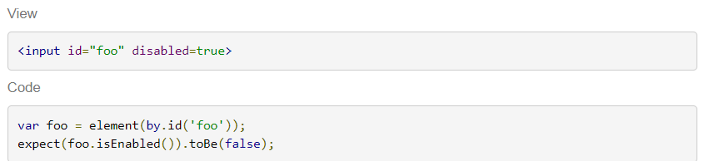
Element.isEnabled

Slide 61
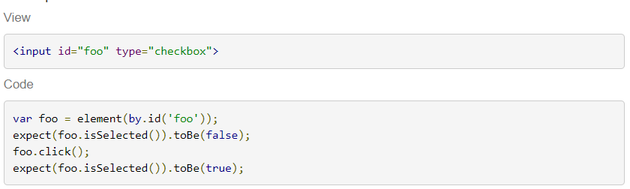
Element.isSelected

Slide 62
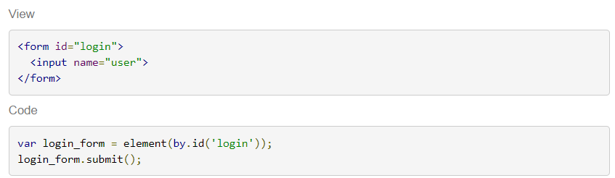
element.submit

Slide 63

Element.clear

Slide 64

Element.isDisplayed

Slide 65

element.takeScreenshot

Slide 66


Slide 67
Element.all(locator)

Slide 68

element.all(locator).then(thenFunction)

Slide 69

$$(cssSelector)

Slide 70

element.all(locator).isPresent()

Slide 71

element.all(locator).first()

Slide 72

element.all(locator).get(index)

Slide 73

element.all(locator).all(locator)

Slide 74

element.all(locator).count()

Slide 75
locators

Slide 76

By.xpath

Slide 77

By.tagName

Slide 78

by.partialLinkText

Slide 79

by.name

Slide 80

By.linkText

Slide 81

By.id

Slide 82

By.css

Slide 83

By.className

Slide 84

by.options(optionsDescriptor)

Slide 85

by.cssContainingText

Slide 86

by.exactRepeater

Slide 87

by.repeater

Slide 88

by.partialButtonText

Slide 89

by.buttonText

Slide 90

by.model(modelName)

Slide 91

by.binding

Slide 92

by.exactBinding

Slide 93
expected condition

Slide 94

ExpectedConditions.elementToBeSelected

Slide 95

ExpectedConditions.visibilityOf

Slide 96

ExpectedConditions.stalenessOf

Slide 97

ExpectedConditions.presenceOf

Slide 98

ExpectedConditions.urlIs

Slide 99

ExpectedConditions.urlContains

Slide 100

ExpectedConditions.titleContains

Slide 101

ExpectedConditions.titleIs

Slide 102

ExpectedConditions.textToBePresentInElement

Slide 103

ExpectedConditions.alertIsPresent

Slide 104

ExpectedConditions.or

Slide 105

ExpectedConditions.elementToBeClickable

Slide 106

ExpectedConditions.and

Slide 107

ExpectedConditions.not

Slide 108
Debugging Protractor Tests

Slide 109


Slide 110


Slide 111


Slide 113


Slide 114


Slide 115


Slide 116


Slide 117


Slide 118


Slide 119


Slide 120


Slide 121


Slide 122


Slide 123


Slide 124


Slide 125



Slide 126


Slide 127


Slide 128


Slide 130


Slide 131


Slide 132


Slide 133

????

Slide 134


Slide 135


Slide 136


Slide 137


